Slide 1


Find the Lag
Ruchir Chheda and Aditya Harakare
Team ID - HA 226126

Slide 2
Yolo V5
The Yolo here solves a very simple problem here which is to find the exact positions of screen and hardware device, considering some error margin. This is actually an overkill, as the actual setup remains the same, but even if it were to change. This will not have any issue.

Slide 3
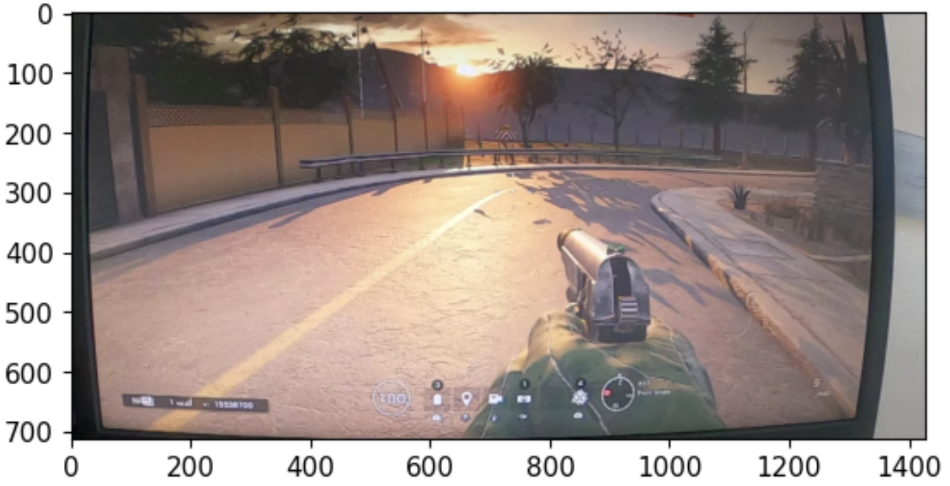
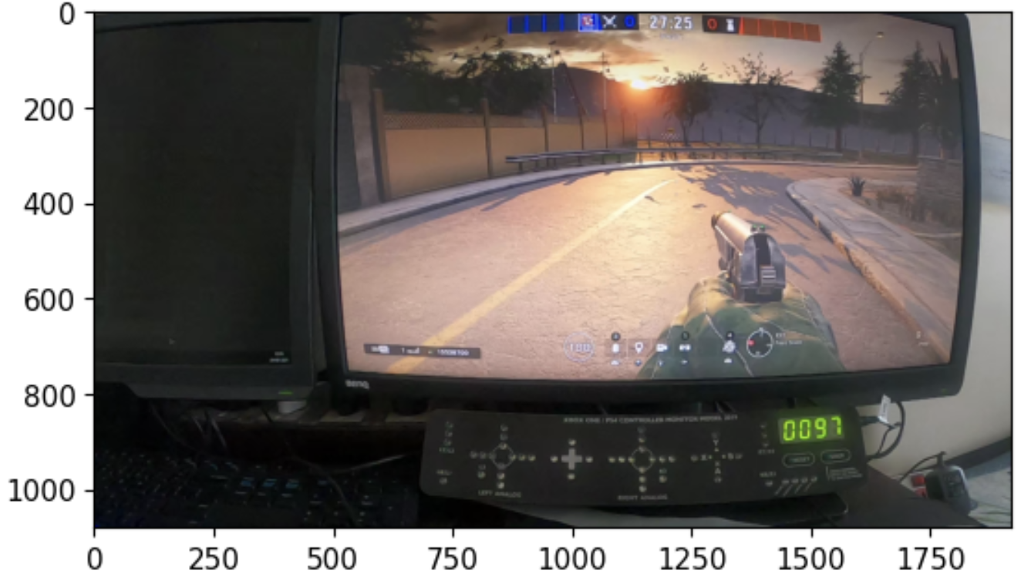
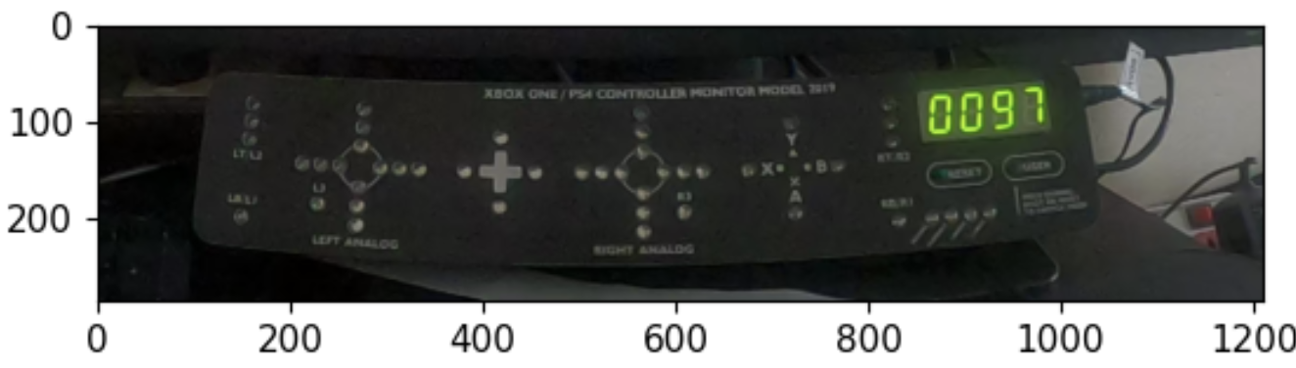
Yolo V5

Slide 4
Hardware Device
We have used a simple blue detection filter, after thresholding and adding double counting safety checks get all the trigger locations.

Slide 5
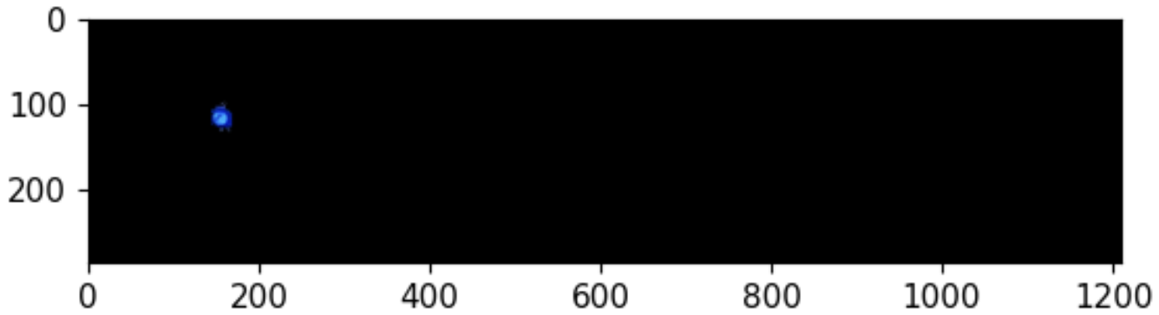
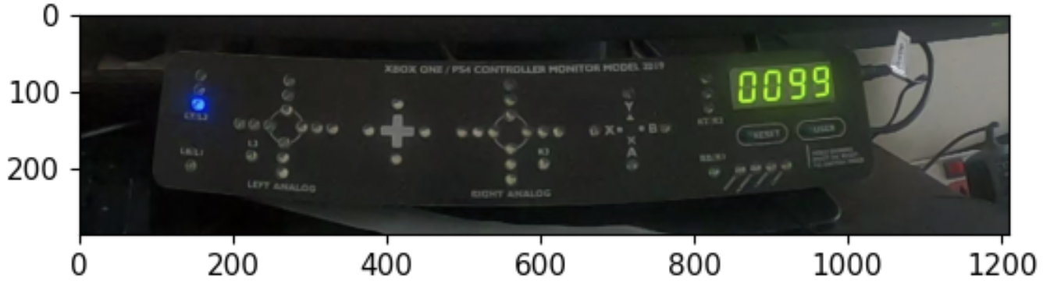
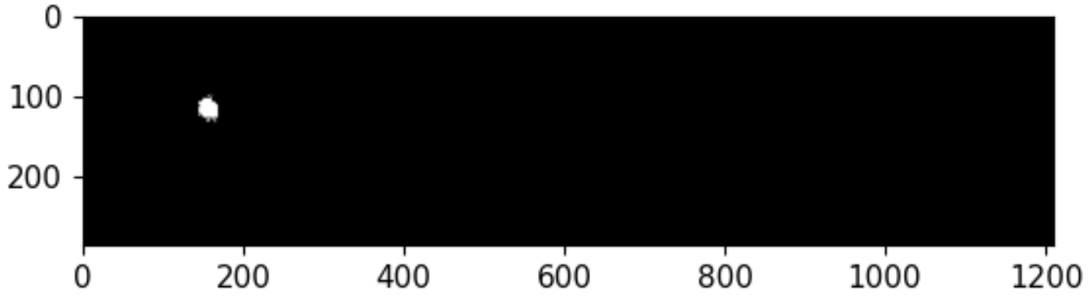
Hardware Device

Slide 6
Screen
We are using an image comparison metric between frames at different instances to create disparities in the images and maximise, we have used methods to make the method more robust. From this we get all the action locations

Slide 7
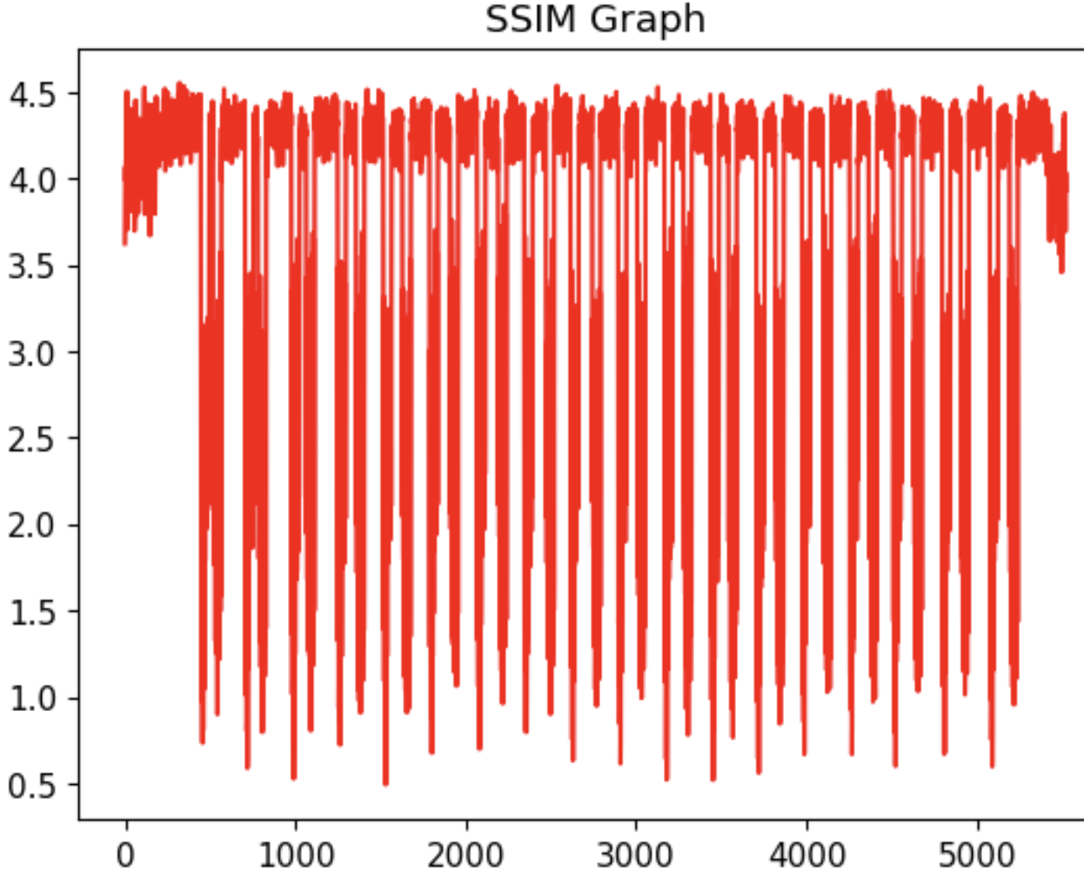
Screen

Slide 8
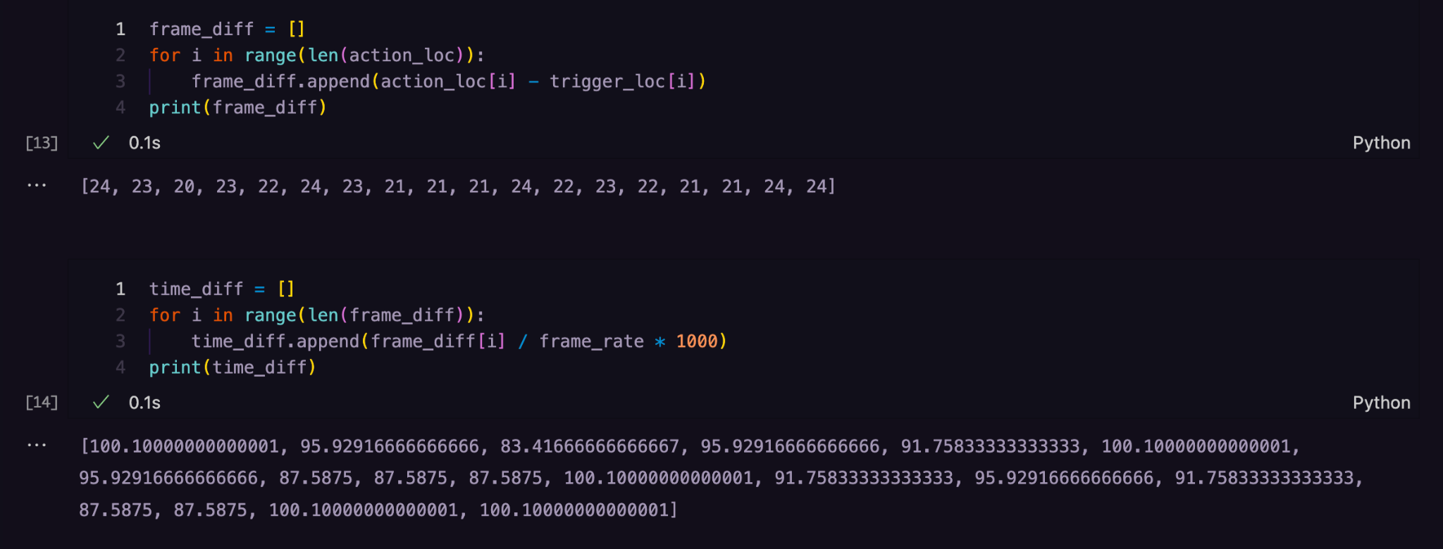
Final Calculations

